Slide 1

Movie Sentiment Analysis
December 6th, 2021
Group 3
Ben Facio, Olivia Hawkins
Chenxi Li, Shen Lim

Slide 2

Introduction
Understanding social media influence on box office returns
Scraping comments from Reddit
Analyzing sentiment scores
Regressing emotions and other variables on returns
Pitch to movie executives to predict how well a movie will do
Using our regression equation on the new Spider-Man movie

Slide 3

Data Sourcing
Shen Lim

Slide 4
Data Sourcing
Goal: Extract comments from relevant "megathreads" from Reddit.
First, identify two megathreads for each movie: the pre-release or "trailer" discussion thread, and the post-release or main discussion thread.
Save all URLs prior to extracting comments to keep track of sources.
There will be (n × 2) posts to extract comments from; where n is the number of movies analyzed.

Slide 5
Data Sourcing – Primary Methods
Two main methods to extract comments: Reddit's official API vs the Pushshift API.
There are advantages and disadvantages for both methods.
Alternatively, one can also scrape posts for comments, since Reddit posts are JSON-ready. However, this can lead to inconsistent results depending on internet connection and browser behavior. Results may not be easily reproducible.

Slide 6
Data Sourcing – The Reddit API
The Reddit API is well-documented and has an easy-to-use Python package: the Python Reddit API Wrapper (PRAW).
Advantages: Results are up-to-date, including most recent edits and scores (karma).
Disadvantages: Very slow due to severe call limits (max 100 items per request). Results are near-instantaneous when working with small requests, but can take hours when scraping posts with thousands of comments.

Slide 7
Data Sourcing – The Pushshift API
A big-data storage and analytics project maintained independently of Reddit.
Advantages: Extract and analyze large quantities of Reddit data efficiently. Two Python packages available: Pushshift API Wrapper (PSAW) and Pushshift Multithread API Wrapper (PMAW).
Disadvantages: Pushshift stores data (e.g. submissions, comments) once close to submission time and does not update it. A major consequence is inaccurate scores (karma).

Slide 8
Data Sourcing – The Pushshift API
The Pushshift API method is more suited to our project.
Due to aggressive rate limits, the official API would take hours to extract comments from a single megathread.
The Pushshift wrapper (PSAW) is faster, and the multithreading wrapper (PMAW) is extremely fast for large posts (>20,000 comments).
Optimal method for project: PSAW or PMAW depending on the number of comments. Reddit's official API will not be used.

Slide 9
Exploring the Data
1. Get top n comments in a subreddit between two dates. Recommended initial n = 20
2. Read the results into a data frame.
3. From the data frame, get unique list of authors.
4. For each author, get the subreddits of their top x comments in the same time period. Recommended x = 10
5. Read the results into a data frame of authors and subreddits.
6. Network the results.

Slide 10
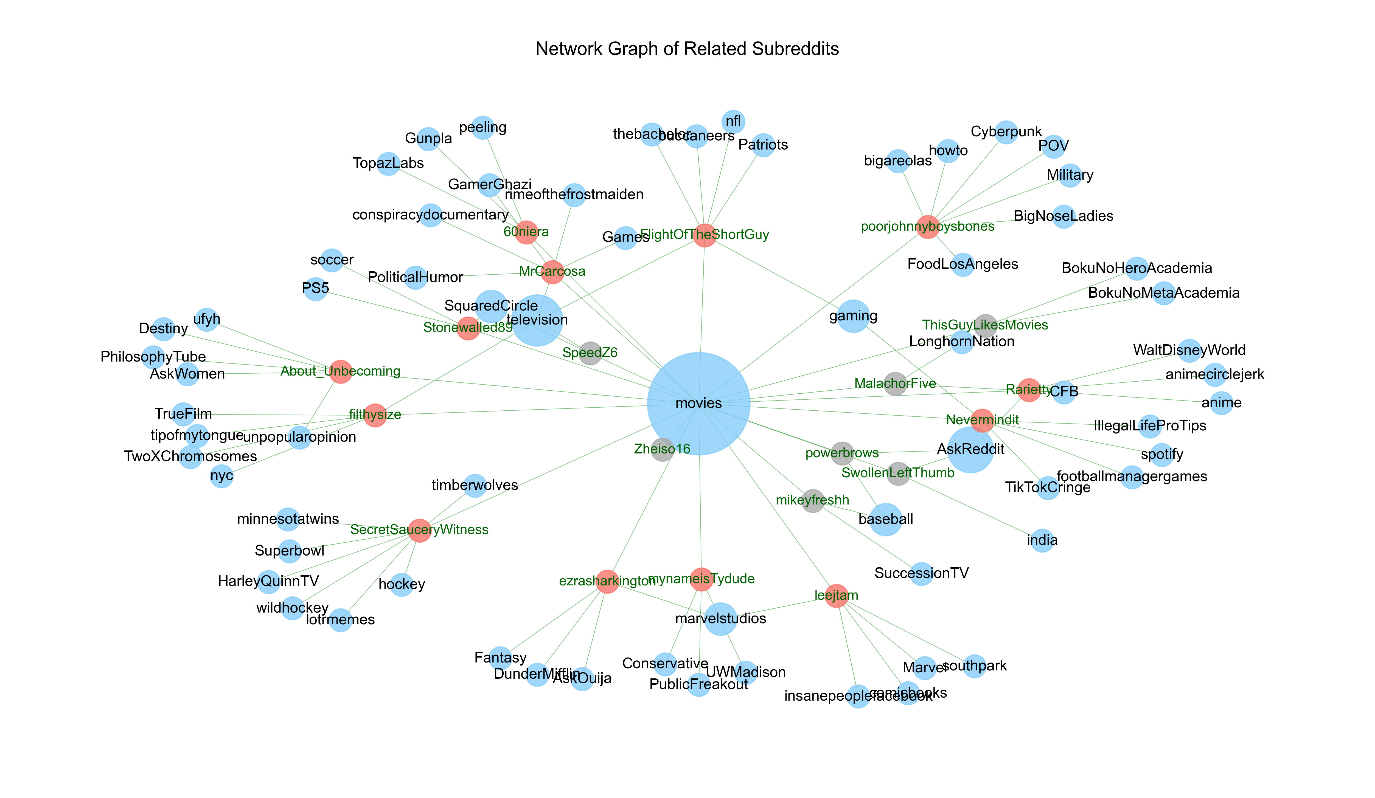

Slide 11
Preparing Data for Analysis
Once extracted, all comments from all 46 posts are cleaned using a comprehensive text-cleaning function.
Analysis will be performed on cleaned and lemmatized (not stemmed) comment text.
Each comment will also have a Boolean attribute depending on whether it is a parent or non-parent comment.

Slide 12
Preparing Data for Analysis
Pre-process:
Remove URLs
Remove non-ASCII text
Replace contractions
Tokenize
Normalize:
Lowercase
Remove punctuation, replace numbers
Remove stopwords
Lemmatize

Slide 13

Getting Sentiment Scores
Chenxi Li

Slide 14
Data
Input
23 movie trailer and 23 movie release .csv files
5K rows for trailer and 12K rows for released on average
Feature
Parent: Boolean; whether the comment is the parent comment
Comment: character; review about the trailer and released movie
Output
46 .csv file
8 emotion score + 2 emotion measurement
4 type of sentiment score

Slide 15
Emotion and Sentiment Score
Emotion
Sentiment Score
Anger
Anticipation
Disgust
Fear
Joy
Sadness
Surprise
Trust
Negative
Positive
Synzhet
Bing
Afinn
NRC

Slide 16
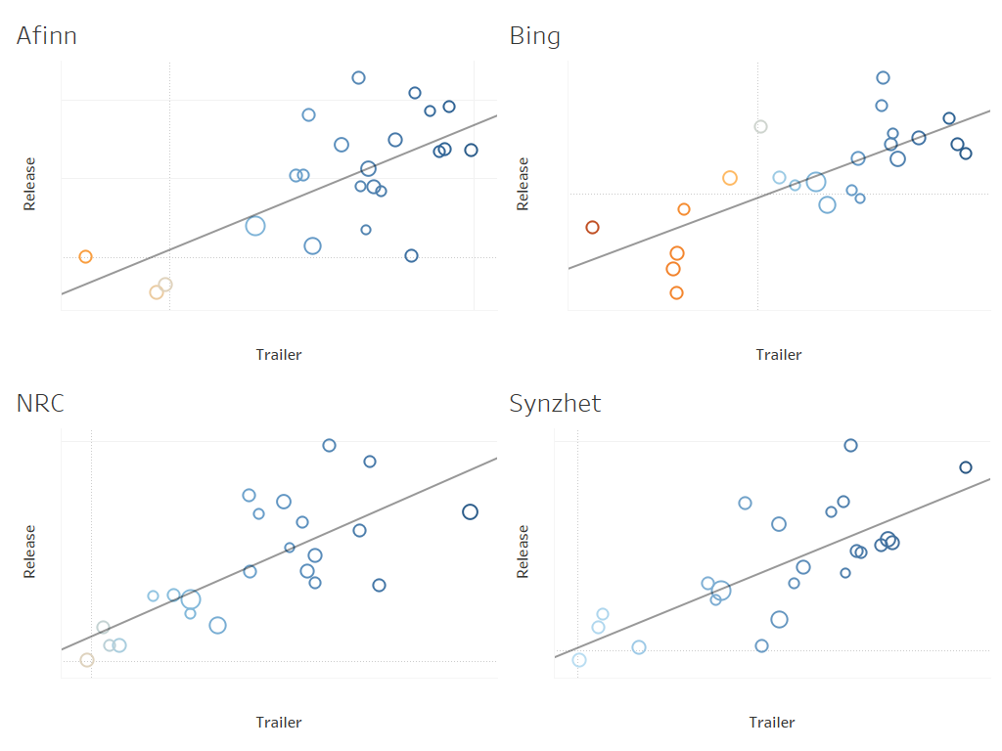
Trailer vs Release
Both Emotion Score and Sentiment score for movie trailer and release has positive relationship.
Typically, score for released movie is higher than trailer.
Notes:
We did a small exploratory analysis for sentiment score. It can be find that trailer’s sentiment score has positive relationship with the released movie.

Slide 17
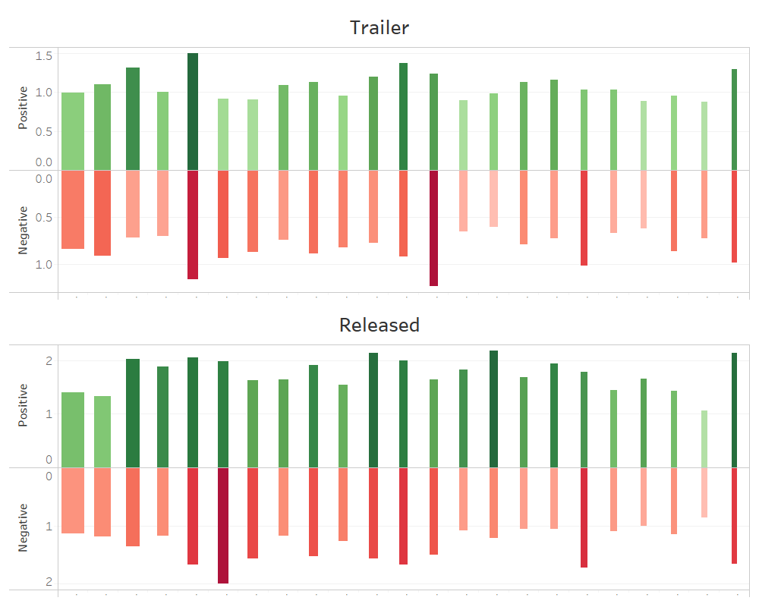
Emotion
Less change compared to sentiment score.
Both positive and negative score increase after movie released.
Emotion also affects the box office of movie.
Notes:
We also try to see if change of emotion directly related with the box office. However, the difference between trailer and release is not as clear as we expected. Therefore, we think it might be better to try to use emotion as one classifier rather than separate predictor, in order to get better performance.

Slide 18
Code Work
For each movie file:
Get the most common emotion by summing the categorical variables and taking column name of the highest number in that row
Append it to the appropriate line in our main file for the regression
Unused data
Rotten Tomato scores
Our goal was to predict, while the scores are reactionary

Slide 19

Interpreting Our Results
Ben Facio

Slide 20
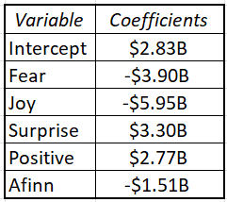
Trailer Comment Interpretation
Regression Results
Most Impactful Variables:
Positive Impact - Surprise
Negative Impact - Joy

Slide 21
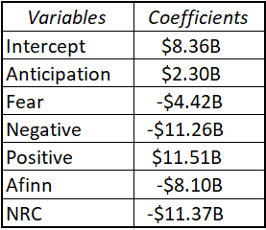
Movie Release Comment Interpretation
Regression Results
Most Impactful Variables:
Positive Impact - Positive Sentiment
Negative Impact - NRC Sentiment

Slide 22
Spider-Man Analysis
Box Office Revenue = 2.84 Billion
- 3.9 Billion(Fear)
- 6 Billion(Joy)
+ 3.3 Billion(Surprise)
+ 2.77 Billion(Positive)
- 1.5 Billion(Afinn)
Variable | Sentiment Score
Fear | 0.5719
Joy | 0.3874
Surprise | 0.2984
Positive | 0.8537
Afinn | 0.3741
$ 1,073,509,000

Slide 23
Summary
Reddit is just one social media platform
Biggest Marvel movie released during the pandemic
23 movies only from 2017-2019
Some coefficients were confusing
We’ll know in 2-3 weeks!

Slide 24
Thanks for Listening!
Questions?

